Slide 1
Experience in Preparing Clinical Data Submission to the FDA Satoru Tsuchiya Dainippon Sumitomo Pharma Co. Ltd. Sam Tomioka Sunovion Pharmaceuticals Inc.

Slide 2
Disclaimer
The views and opinions expressed in the following PowerPoint slides are those of the individual presenter and should not be attributed to Drug Information Association, Inc. (“DIA”), its directors, officers, employees, volunteers, members, chapters, councils, Special Interest Area Communities or affiliates, or any organization with which the presenter is employed or affiliated.
These PowerPoint slides are the intellectual property of the individual presenter and are protected under the copyright laws of the United States of America and other countries. Used by permission. All rights reserved. Drug Information Association, Drug Information Association Inc., DIA and DIA logo are registered trademarks. All other trademarks are the property of their respective owners.

Slide 3
Clinical Data Submission?
Just ZIP SAS datasets, and submit them!
CDISC standards need to be used!!
There are additional FDA’s rules!!!
How much efforts should be made?

Slide 4
NDA and sNDA submissions in 2009 and 2011
23 Phase 1
10 Phase 2 (Double Blind/Open label)
8 Phase 3 (Double Blind/Open label)
PopPK, exposure-QTc analysis
Including some trials using Japanese language
Activities
Conversion of legacy datasets to SDTM with translation
Generation of ISS/ISE from SDTM datasets
Preparation of efficacy analysis datasets to accommodate FDA’s requirements for selected Phase2/3 studies (NOT ADaM)
Generation of Define files
[Tomioka 2011]

Slide 5
Challenges: Organization Level
Our team in the US was relatively new and small when the NDA project began.
No prior NDA submission experience as a company.
New processes had to be established.

Slide 6
Challenges: Project Level
Multiple vendors were involved in the submission preparation activities.
All of legacy studies conducted in US and EU spanning 14 years were outsourced studies with essentially no standards and very limited DM and Biostatistics oversight.
Annotations of raw datasets were missing for many studies.
Analysis datasets were not received for some studies.
Not sure which files were final version
Approx. 20% of studies were in Japanese.

Slide 7
Today’s outline
Overview: Clinical data submission to the FDA
Points to discuss/agree with the FDA
Examples of FDA’s rule
Implementation
Working with the multiple vendors
QC process
Translation
FDA reviewer’s analyses
Statistical review report
Lessons Learned

Slide 8
6-12 months prior to NDA
Pre-NDA/BLA
meeting
NDA
Submission
Pilot
Submission
On-going phase3 trial
ISE/ISS analyses
Legacy data conversion to SDTM
Preparation of analysis datasets
Preparation of Define files
Notes:
Samへの質問：
・レガシーデータconversionはいつから始めたっけ？→2Q 2008
・レガシーデータconversionの大体の予算は？→$1M (翻訳、コーディング等も含む）
・Phase 2試験データのパイロットsubmissionはいつごろでしたか？→Aug 2009
・そもそも、SDTMのconversionに決めた理由はなんでしたっけ？
→レガシーデータは全く標準化されていなかった。
→ISS/ISEのデータセットを作成する際楽だから。
→FDAの質問等にもすばやく対応できるだろうと考えた。
メモ：Pre-NDA meeting was held on 5/22/2009.
In-house Resource: 4 SDTM programmers, 1 ISS, ISE programmer, 4-5 statisticians

Slide 9
Pre-NDA/BLA Meeting
CDER 21st century Review Desk Reference Guide (2012):
The purpose of a pre-NDA/BLA meeting is to discuss format and content of the anticipated application, including labeling and REMS (if applicable), presentation of data, dataset structure, acceptability of data for submission, as well as the projected submission date of the application.
FDA Study Data Specifications (2012):
Prior to the submission, sponsors should discuss with the review division the datasets that should be provided, the data elements that should be included in each dataset, and the organization of the data within the datasets.

Slide 10
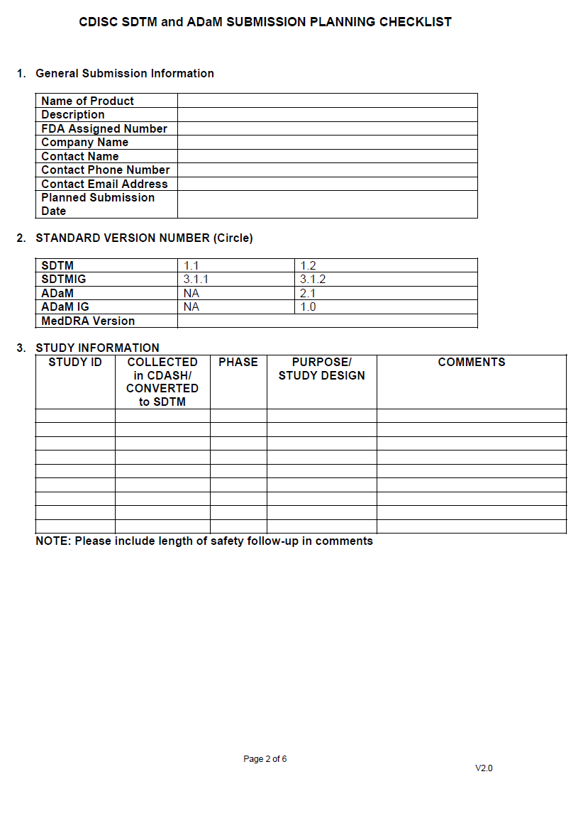
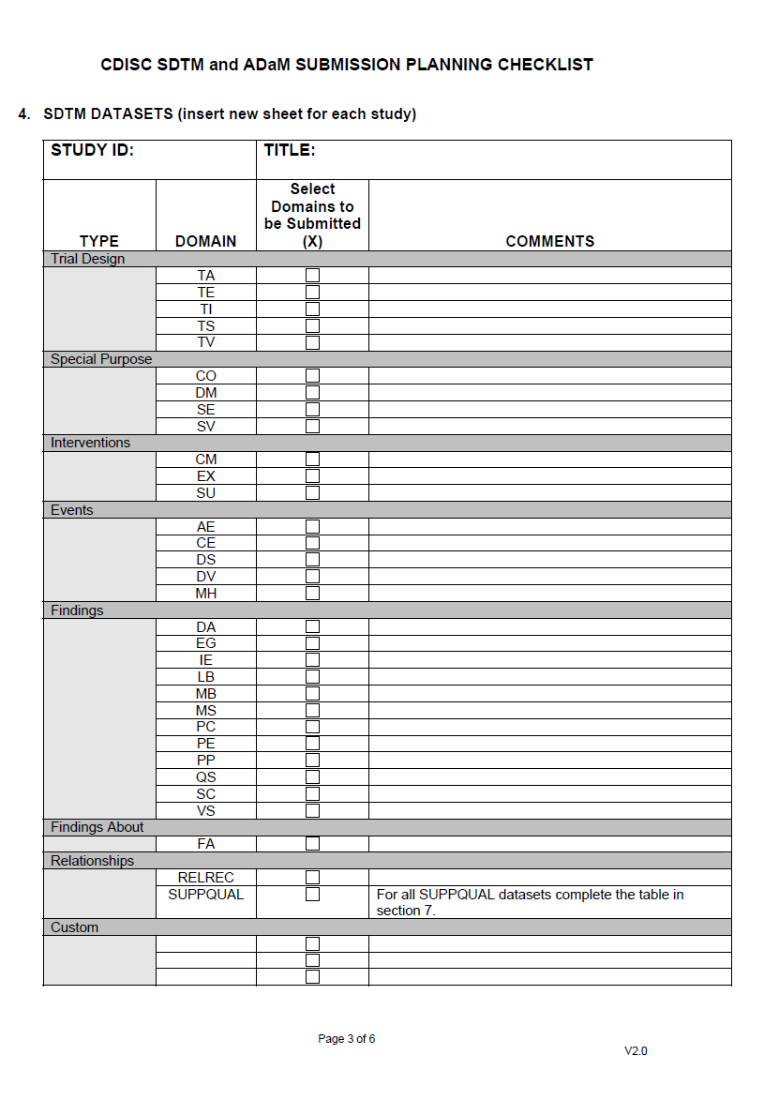
CBER: CDISC SDTM and ADaM SUBMISSION PLANNING CHECKLIST
http://www.fda.gov/BiologicsBloodVaccines/DevelopmentApprovalProcess/ucm209137.htm

Slide 11
Points to discuss/agree with the FDA (1/2)
1. Which datasets should be submitted?
Raw dataset
SDTM 1.1 SDTMIG 3.1.1, for Phase 2/3
Analysis dataset
(Non-ADaM) efficacy datasets, for Phase 2/3 DB
Pooled analysis datasets
(Non-ADaM) ISE and ISS datasets
M&S
Analysis dataset of PopPK and exposure-QTc analysis
Notes:
Samへ質問：
PopPK、Exposure-QTcって何を提出したのか覚えていますか？解析用データセット（SAS）とSASプログラム？
→解析用データセット（SAS）とSASプログラム) と define.pdf
PKデータってどうやって提出したっけ？
→SDTM.PC を提出。
PK parameter（AUCとかCmax）はどうしたっけ？WinNonLinのファイル？
→SDTM.PPを提出。

Slide 12
Points to discuss/agree with the FDA (2/2)
2. Which SAS programs should be submitted?
Primary/key secondary efficacy, for Phase 2/3 DB
Important analyses on ISE/ISS
3. Others
Statistical analysis plan for ISE and ISS
Documentation type (define.xml or define.pdf)
Need of pilot submission
Notes:
Samへ確認：
-deifneファイルは、当時xmlとpdf、当時はどっちでも良かったんだよね？
SDTMはXMLにして、それをFDAと合意したのでしょうか？
今はまだdefine.pdfで良いのでしょうか？
→当時から、CDISCで提出するときは、XMLが要求された。Non-CDISCの場合は、PDF
で良かった。

Slide 13
Example #1: Trial using CDISC standards
EDC
(eCRF)
SAS
program
SAS
program
SDTM
ADaM
TLFs
for CSR
Central
lab
Define.xml
Define.xml
Central
ECG
SDTM
XPT
ADaM
XPT

Slide 14
Example #2: Trial using non-CDISC standards
Source datasets
EDC,
Paper CRF
SAS
program
SAS
program
Analysis
datasets
TLFs
for CSR
Central
lab
Central
ECG
Add variables
Define.xml
SDTM
SDTM
XPT
Define.pdf
Analysis
dataset
XPT

Slide 15
Example #3: Trial using non-CDISC standards with Japanese language
Translation
Source datasets
EDC,
Paper CRF
SAS
program
SAS
program
Analysis
datasets
TLFs
for CSR
Central
lab
Central
ECG
Add variables
Define.xml
SDTM
SDTM
XPT
Define.pdf
Analysis
dataset
XPT

Slide 16
Example of FDA’s rule (1/3)
Item | Rule
File Size | <1GB
File Format | SAS transport file (ver.5)
Max. Length of Dataset Label | 40
Max. Length of Variable | 8
Max. Length of Variable Label | 40
[FDA Study Data Specifications, 2012]

Slide 17
Example of FDA’s rule (2/3)
General Considerations for Analysis Datasets
At least one analysis dataset should be labeled in the data definition file as containing the primary efficacy data.
When a dataset contains multiple records per subject, a variable for relative day of measurement or event and variables for visit should be included. In addition to a protocol-scheduled visit variable, include at least two timing variables; a character variable describing the visit (e.g. WEEK 8) and a corresponding numeric variable (e.g. 8). These two variables are measures of time from randomization.
Core variables should be listed after the key variables (USUBJID and visit) and included on each analysis dataset. Core variables include study/protocol, center/site, country, treatment assignment, sex, age, race, analysis population flags (e.g. ITT, safety) and other important baseline demographic variables.
For textual data that have been mapped to numeric codes, provide two variables, one with text and one with numeric codes.
Dates should be formatted as numeric in the analysis datasets even if dates are in ISO8601 or another character format in the raw data. This formatting will facilitate calculations, such as duration.
[FDA Study Data Specifications, 2012]

Slide 18
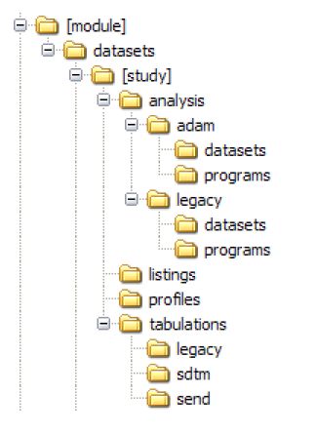
Example of FDA’s rule (3/3)
eCTD directory structure
Contains ADaM analysis datasets
Contains respective programs
Contains non-ADaM analysis datasets
Contains respective programs
Contains non-SDTM tabulation datasets
Contains SDTM datasets
Contains SEND datasets (Animal tox. data)
[FDA Study Data Specifications, 2012]

Slide 19
Summary of our activities
Conversion of legacy datasets to SDTM 1.1/ SDTMIG 3.1.1
Translation was necessary for some studies
Generation of ISS/ISE from SDTM datasets
Preparation of efficacy analysis datasets with FDA’s requirements for selected Phase2/3 studies (NOT ADaM)
Generation of Define files

Slide 20
Implementation
Working with the multiple vendors
QC process
Translation

Slide 21
Working with multiple vendors
Vendor B, Vendor C
Vendor A
Coding Update
LB
standardization
Translation
Vendor B
Raw
datasets
SDTM
SDTM
ISE/ISS
datasets
TLFs
for CTD
Vendor D
Analysis
datasets
Analysis
datasets
Vendor D
eCTD
Add variables
Notes:
Samへ質問：
・どちらのSDTMをFDAに提出したのか。Stackable?
→NDAはStackable(最新のcodingも含む)を提出。Stackable→ISS/ISE data
→Bipolarはnon-stackableを提出。raw data→analysis data→pooled data, raw data→non-stackable SDTM
・具体的なtranslationの方法はどうだっけ？
→Raw dataから2バイトの文字を含む変数から、ユニークな文字列を抽出、Excelに出力して、翻訳業者に翻訳を依頼した。
→Raw dataに対応する英語の文字列を格納する変数を追加し、翻訳された文字列をインポートした。
・具体的なLB standardizationの方法？
→Rawからtest name, unit等を抽出して、標準化されたtest name, unit, conversion factorなどにマップしたメディカルレビュー用のマッピングファイルを作成。
・具体的なcoding updateの方法？
→Rawからオリジナルのコーディングデータを抽出。最新の辞書を基にnumeric code等をキーとして利用し、古いcoded termと比較した。termがマッチしない場合は、新しいtermの候補をメディカルレビュー用にマップした。

Slide 22
Working with multiple vendors
Planning
With timeline of all activities up to submission
To help all members to understand the process
Project management, DM, Biostat, RA, etc.
To secure appropriate resources
Vendor selection
Experiences of SDTM conversion and/or NDA submission
Communication
Regular meetings with vendors
To share information and timelines
The information was subject to constant shifts as further details were obtained.
Notes:
Samへの質問：
-Samの資料には、CDISC certified vendorsと書いてあったのだけど、それって何か決まりがあるのでしょうか？ 日本のvendorでそんな会社あるのかな？
→今現在はCDISC Registered Solution Providerと呼ばれているようです。
http://www.cdisc.org/rsp

Slide 23
Example of QC process for SDTM conversion
Vendors
Performed parallel programming for all datasets.
Performed SDTM conformance checks for all SDTM datasets.
Comparison of SDTM against the legacy CSR Tables (traceability check).
Sponsor
Acceptance check / Validation
Review SDTM specification/annotated CRF
Parallel programming of the key datasets.
Compliance checks
Checks were ran to ensure that the datasets meets the eCTD/SDTM requirements.
Notes:
Samへ質問：
-WebSDM checkは、うちの会社でやったんだっけ？あるいはオクタゴン？ Takeとオクタゴン？
→WebSDM checkはＴＡＫＥ
→Bipolar sNDAの時はOpenCDISCを利用。

Slide 24
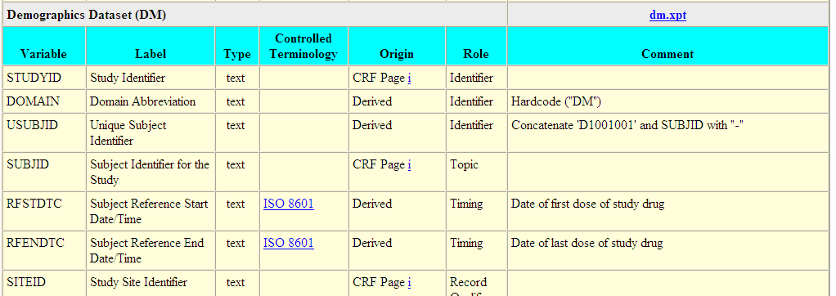
Example of QC process of define.xml
Sponsor
Programmatically compared against the SDTM datasets and IG.
Comment fields were manually checked.
Notes:
Samへ質問
どうやって、プログラムを用いて、IGとチェックしたのでしょうか？
→データセットのメタデータの部分はdefine.xmlからデータセットを作成し、proc contentsから作成されるデータセットやデータセットにしたＩＧを比較した。IGはCDISCからエクセル版がリリースされている。
→ＣＲＦのペーじ部分は、blankCRFとdefine.xmlからデータセットを作成し比較した。
→コメント部分はマニュアルチェック。
Comment fileldはマニュアルチェックしかないんだよね？

Slide 25
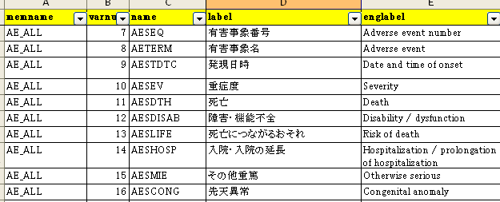
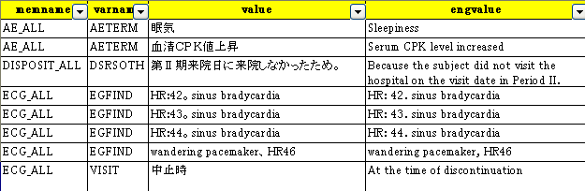
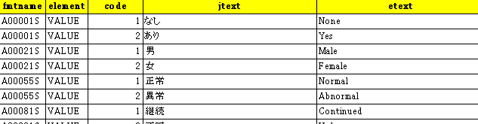
Translation
One vendor performed translation after unique strings are extracted from SAS datasets.
Variable metadata
Distinct Values
SAS format
Notes:
Samへの質問：
-translationで具体的に何をやったのかがスライドではよくわかりませんでした。今度教えてください。

Slide 26
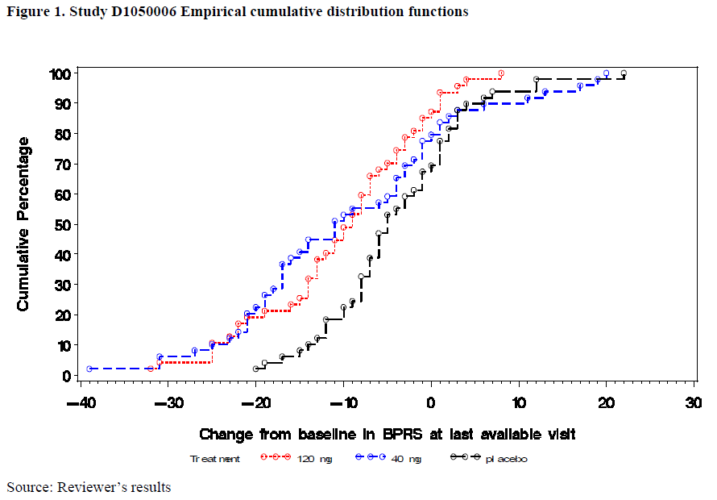
FDA statistical review report (1/3)

Slide 27
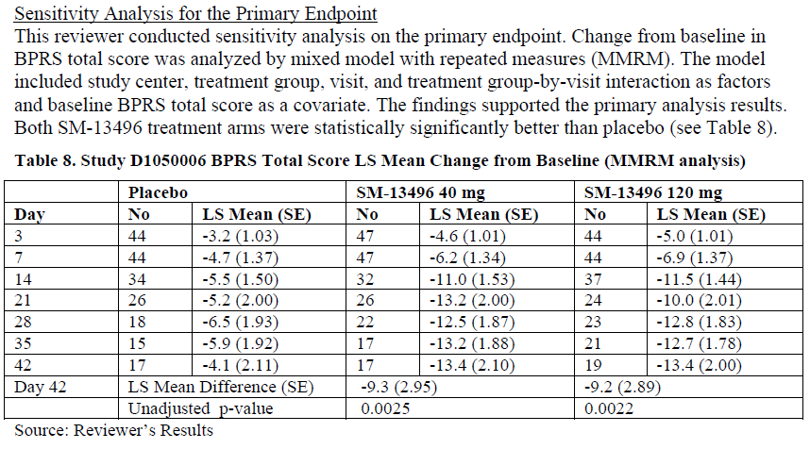
FDA statistical review report (2/3)

Slide 28
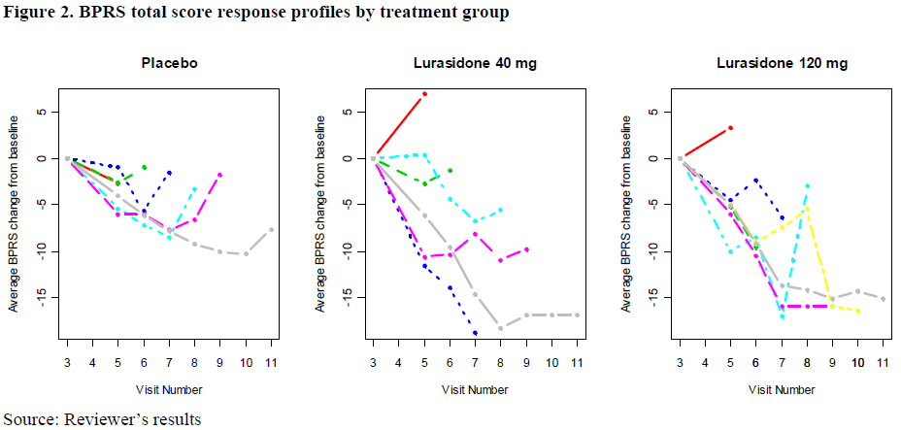
FDA statistical review report (3/3)

Slide 29
Lessons Learned (1/2)
Planning is crucial.
To organize many complicated activities
To secure appropriate resources
Good communication is the key to success.
Project management, DM, Biostat, RA, etc.
Multiple vendors
FDA
Training is essential.
CDISC standards (e.g., SDTM, ADaM, Define.xml, etc.)
Learning current information

Slide 30
Lessons Learned (2/2)
Standardization efforts must be made from the beginning;
The unpredictable nature of data from legacy studies caused the mapping process to be extremely difficult.
FDA encourages sponsor to use the SDTM, ADaM at every opportunity, e.g., when the protocol is submitted.
Creating analysis datasets (ADaM) from SDTM would keep the transparency and consistency.

Slide 31
Summary
Implement CDISC based standards across the entire data lifecycle would save cost and time.
Sponsor can provide data and supporting documentation that establish a clear path from data collection through to analysis.
CDISC conformance is important, but 1) quality of content and 2) analysis plans (i.e., how to use the data?) are more important and must be considered.

Slide 32
Reference
Sam Tomioka, Steven Huang, FDA Submission of Legacy Data Using CDISC Standards, CDISC workshop Japan, 2011
Sam Tomioka, Mark Williams, NDA Submissions: Reflections and Lessons Learned from a Recent and Successful Electronic NDA Submission and Approval Involving the CDISC SDTM Conversion of 42 Individual Legacy Clinical Studies, CDISC interchange Europe, 2011
FDA web-page Study Data Standards Resources
http://www.fda.gov/forindustry/datastandards/studydatastandards/default.htm
FDA Study Data Specifications (2012):
http://www.fda.gov/downloads/ForIndustry/DataStandards/StudyDataStandards/UCM312964.pdf
CDER 21st century Review Desk Reference Guide (2012):
http://www.fda.gov/downloads/AboutFDA/CentersOffices/CDER/ManualofPoliciesProcedures/UCM218757.pdf
FDA statistical review report
http://www.accessdata.fda.gov/drugsatfda_docs/nda/2010/200603Orig1s000StatR.pdf

Slide 33
FDA comment (2010)
We encourage you to submit future NDA data (efficacy and safety) using the CDISC (Clinical Data Interchange Standards Consortium), such as SDTM (Study Data Tabulation Model), ADaM (Analysis Data Model) standards.
Standardization of data structures and terminology will facilitate a mode efficient and comprehensive data review.
For more information please refer to http://www.cdisc.org or the following link from FDA web site: http://www.fda.gov/downloads/Drugs/DevelopmentApprovalProcess/FormsSubmissionRequirements/ElectronicSubmissions/UCM199759.pdf

